Slide 1
Tech World .com
a PHP Website for technological information
Submitted by
Faisal Ahmed
Roll : 1607048

Slide 2
Design tools
HTML
CSS
Bootstrap
JavaScript
PHP

Slide 3
Features of this website
Login
Sign Up / Registration
Post
User
Comments

Slide 4


Slide 5


Slide 6


Slide 7


Slide 8
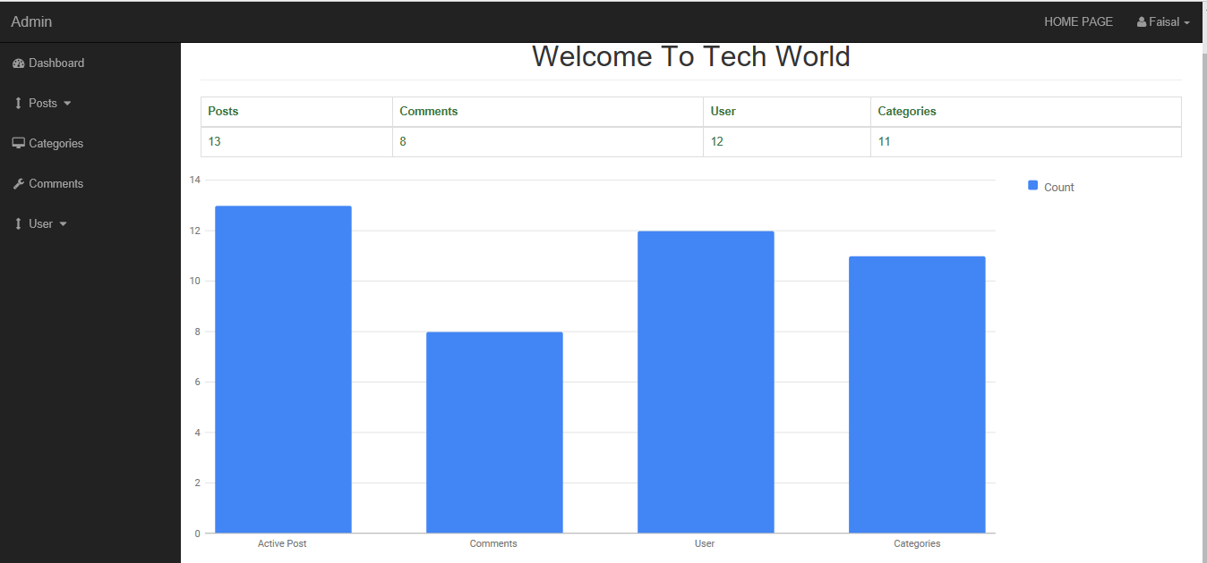

Slide 9
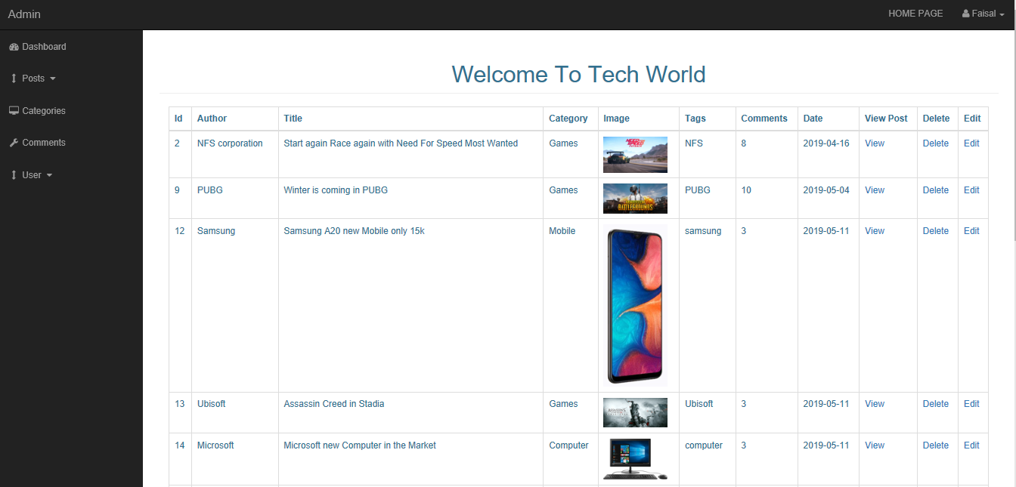

Slide 10
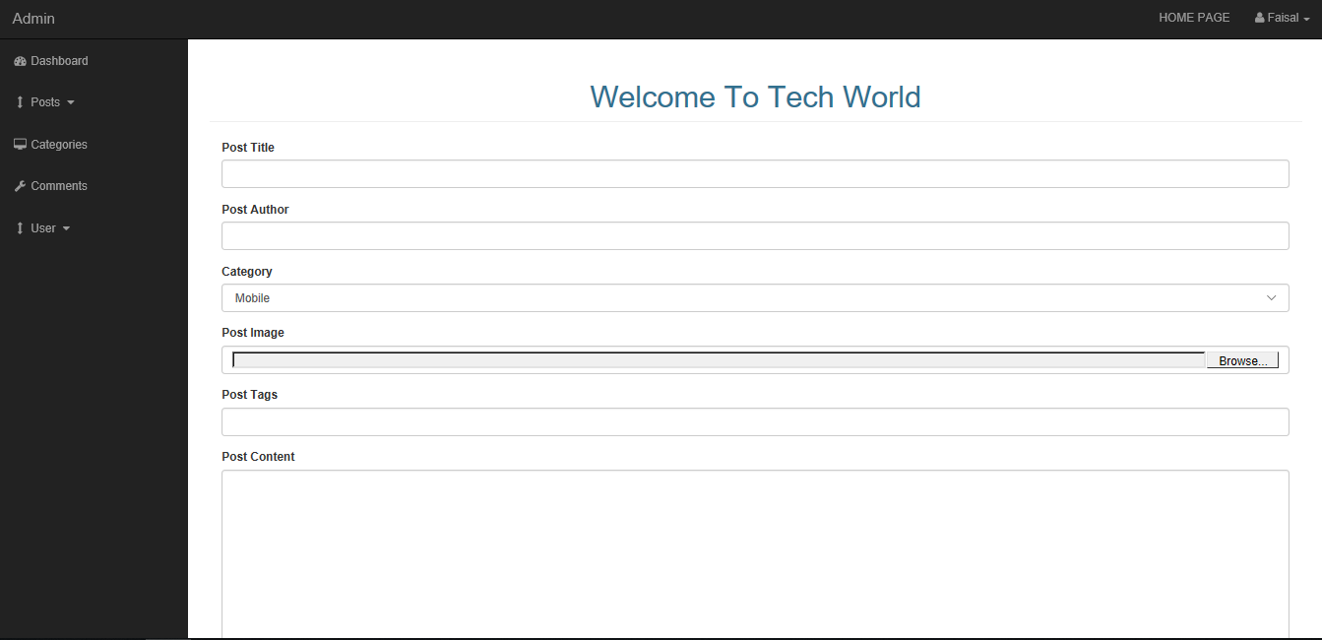

Slide 11


Slide 12
Thank You

